Slide 1
Software Architecture Design Methods
Lecturer: Ngo Huy Bien
Software Engineering Department
Faculty of Information Technology
VNUHCM - University of Science
Ho Chi Minh City, Vietnam
nhbien@fit.hcmus.edu.vn

Slide 2

Objectives
To apply systematic methods to create a software architecture.

Slide 3

Contents
The Attribute-Driven Design
(ADD) Method.
Viewpoints and Perspectives.

Slide 4

References
Philippe Kruchten (1995). Mommy, Where Do Software Architectures Come From.
Humberto Cervantes and Rick Kazman (2016). Designing Software Architectures - A Practical Approach. Addison-Wesley Professional.
Christine Hofmeister et al. (2007). A General Model of Software Architecture Design Derived From Five Industrial Approaches.
Nick Rozanski and Eoin Woods (2012). Software Systems Architecture: Working with Stakeholders Using Viewpoints and Perspectives. Addison-Wesley Professional.
Daniel Perovich et al. (2009). Model-Driven Approach to Software Architecture Design.
Jan Bosch and Peter Molin (1999). Software Architecture Design Evaluation and Transformation.

Slide 5
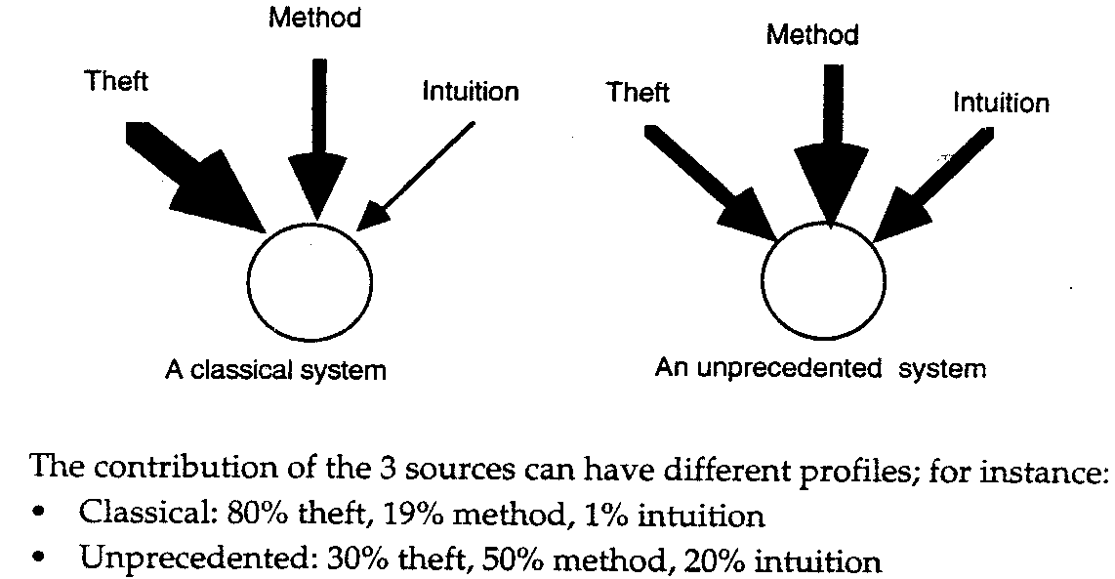
Architecture Sources [1]

Slide 6


Slide 7
The Attribute-Driven Design (ADD) Method
The attribute-driven design (ADD) method can be used for creating
  the design of a greenfield system for a mature (i.e., well-known) domain.
  the design of a greenfield system for a domain that is novel (i.e., a domain that has a less established infrastructure and knowledge base)
  the design for making changes to an existing system (brownfield).
Each one of these categories involves a different roadmap in terms of the sequence of goals that you should perform across the design iterations.

Slide 8
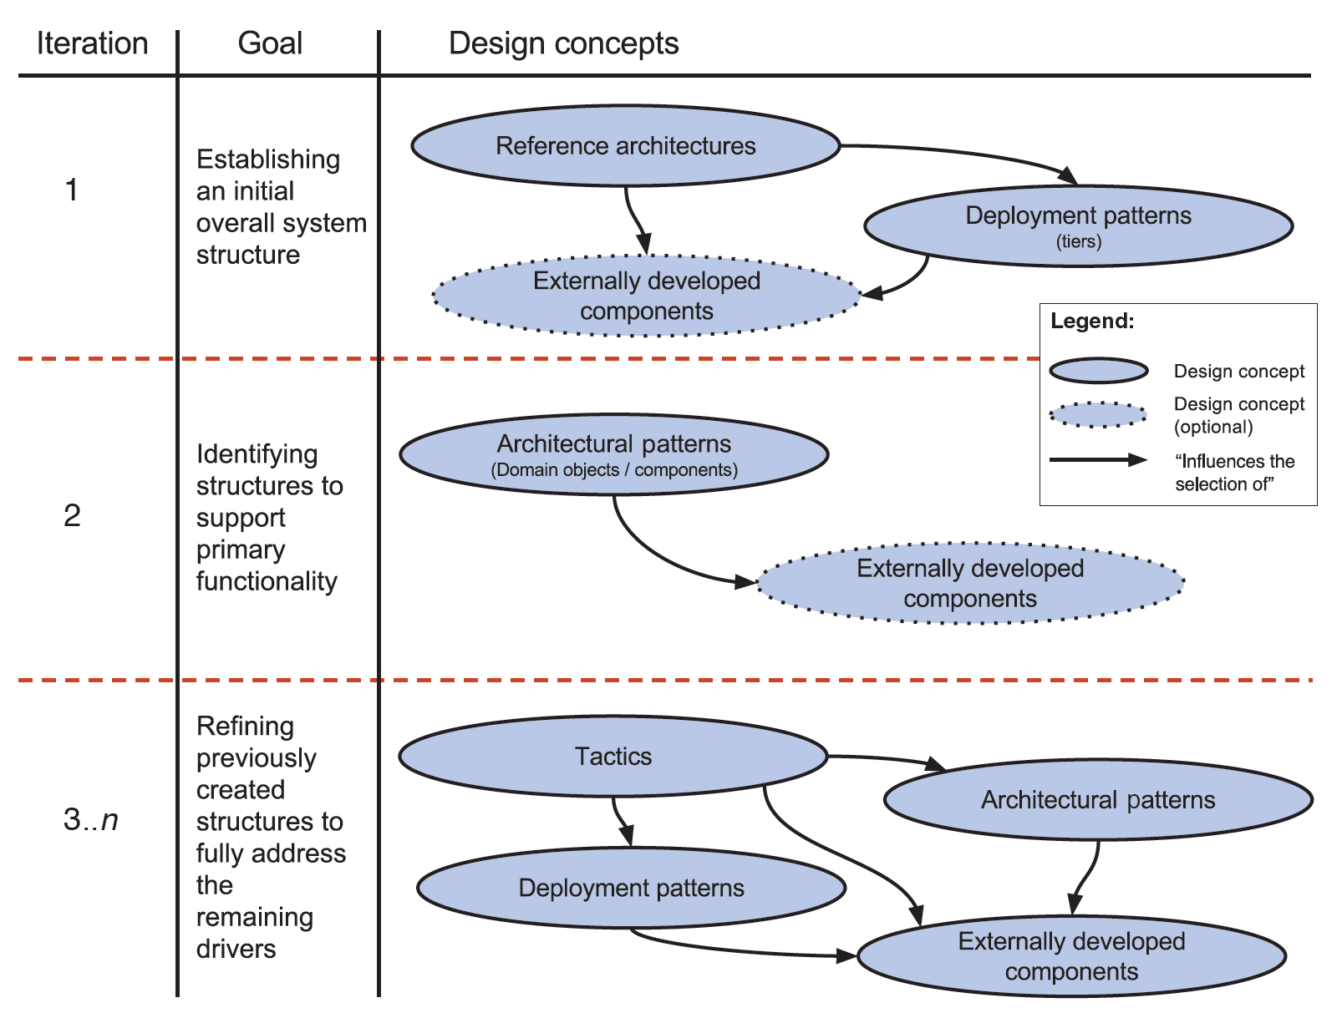
Design of Greenfield Systems for Mature Domains [2]

Slide 9

Design of Greenfield Systems for Novel Domains
Reference architectures may not exist and there may be few, if any, externally developed components.
General-purpose design concepts such as tactics and patterns can guide you.
Your design goal will focus on the creation of prototypes so that you can explore possible solutions to the challenge that you are facing.

Slide 10

Design for an Existing System (Brownfield)
You may also be making architectural changes to an existing system for the purpose of refactoring.
When refactoring, you change the architecture of an existing system, without altering its functions, to reduce technical debt, to introduce technology updates, or to fix quality attribute problems.

Slide 11

Round 1: Inputs
Business Cases
System Requirements
  Use Case Model / User Stories / Story Map
  Quality Attribute Scenarios
  Constraints
  Architectural Concerns
    Languages and technologies.
    Initial system structure.
    Allocating work for members of development team.

Slide 12
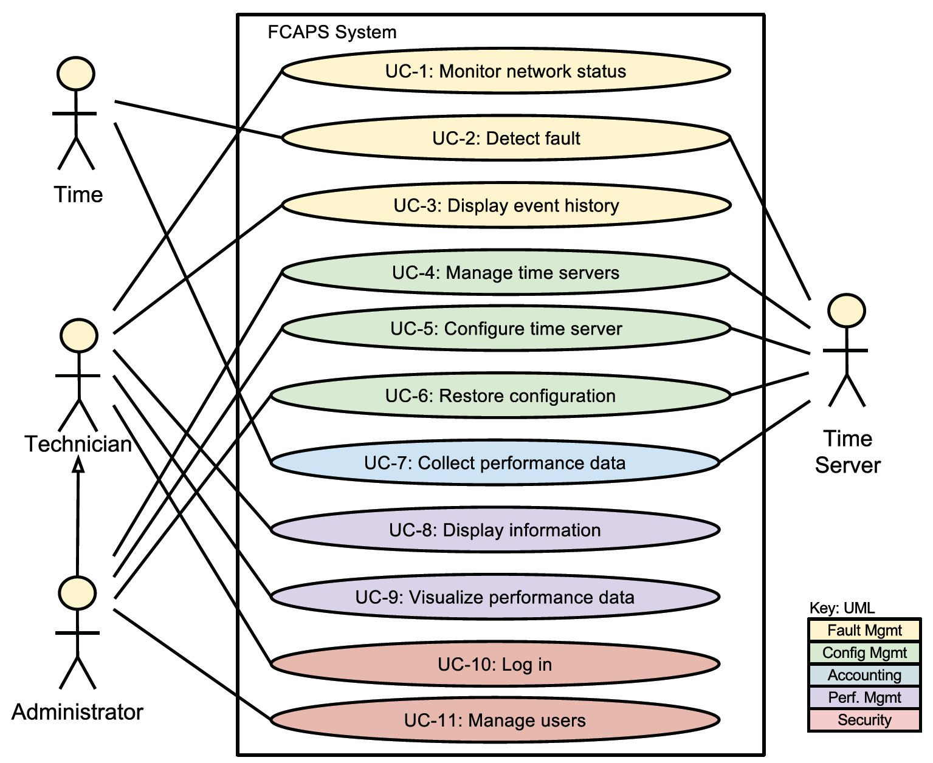
FCAPS System
FCAPS is an acronym for fault, configuration, accounting, performance, and security.

Slide 13
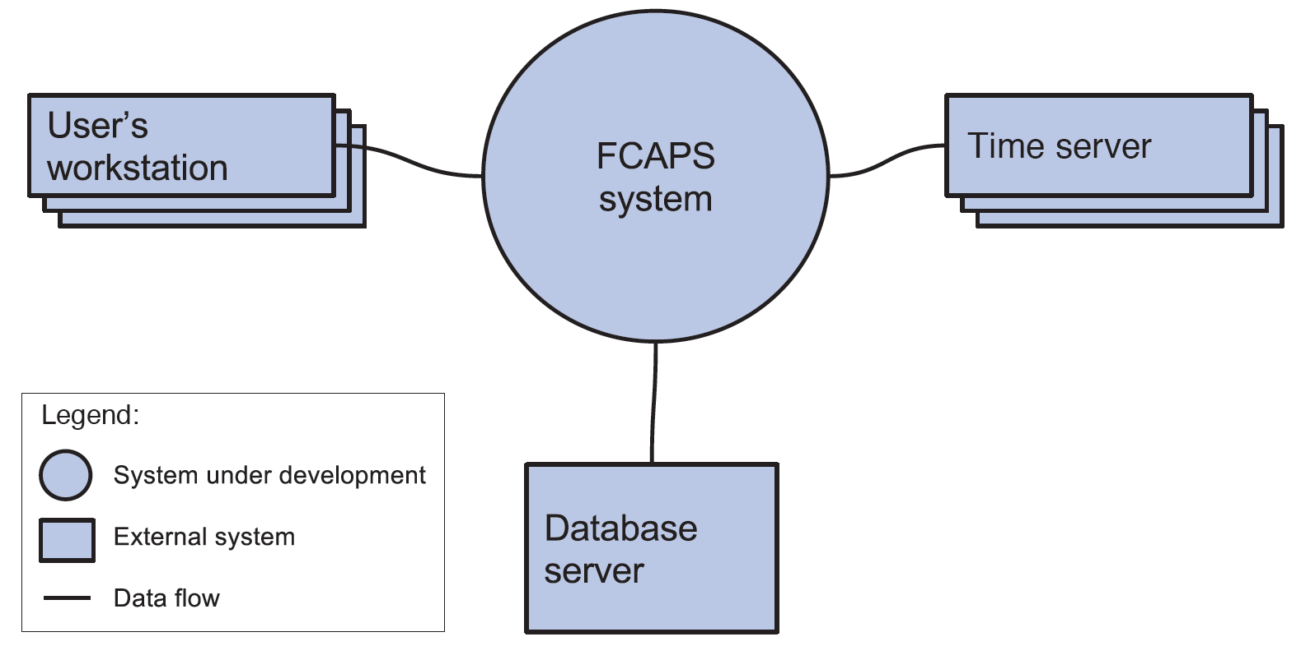
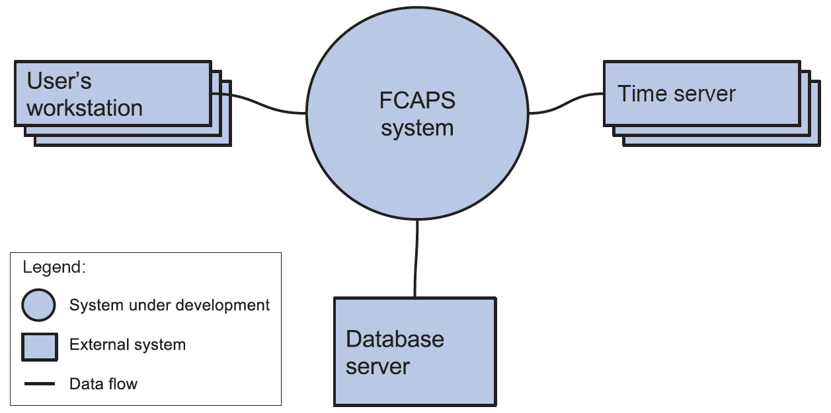
Context Diagram

Slide 14
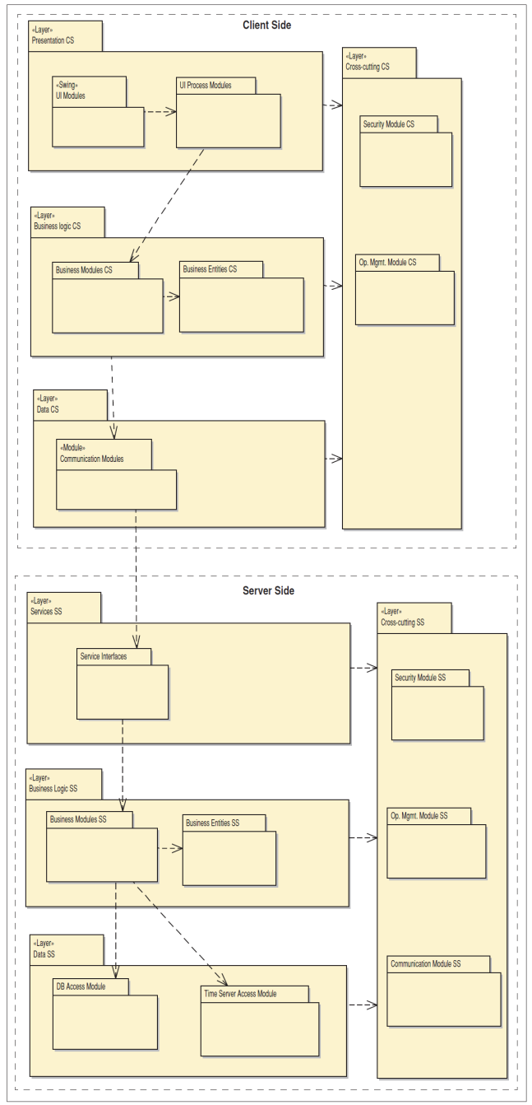
Overall System Structure
Inputs:
  Architectural styles
  Reference architectures
  Programming languages
  Technologies
Method: Decomposition

Slide 15
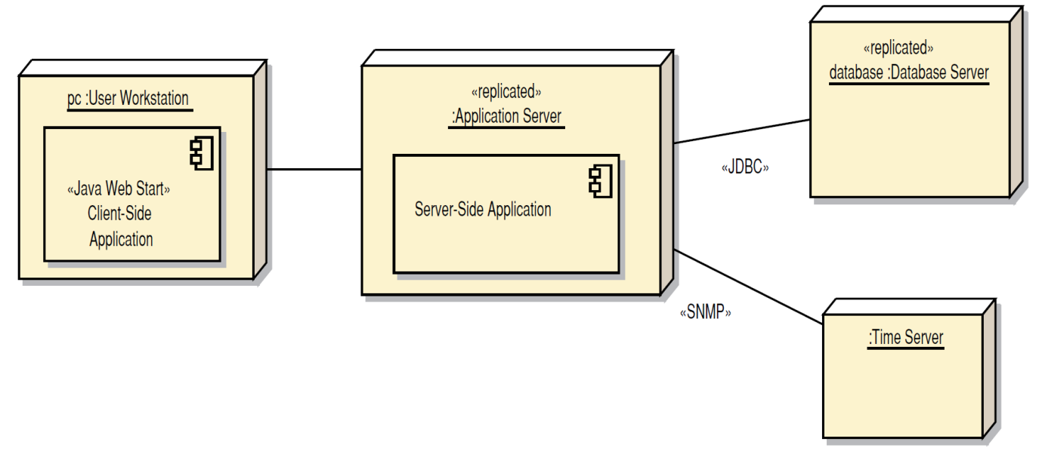
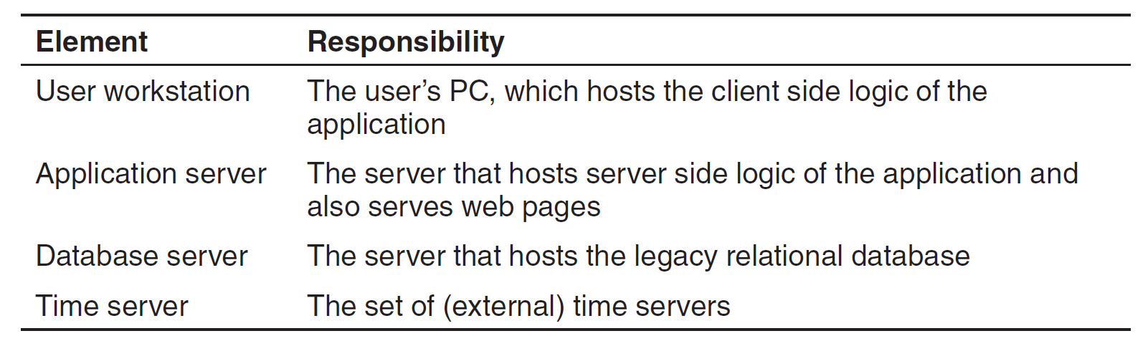
Deployment Diagram
Decomposition
Reference architectures
Architectural styles
Programming languages
Technologies

Slide 16
Round 2: Inputs
Overall system structure.
Deployment diagram.
A primary workflow.

Slide 17
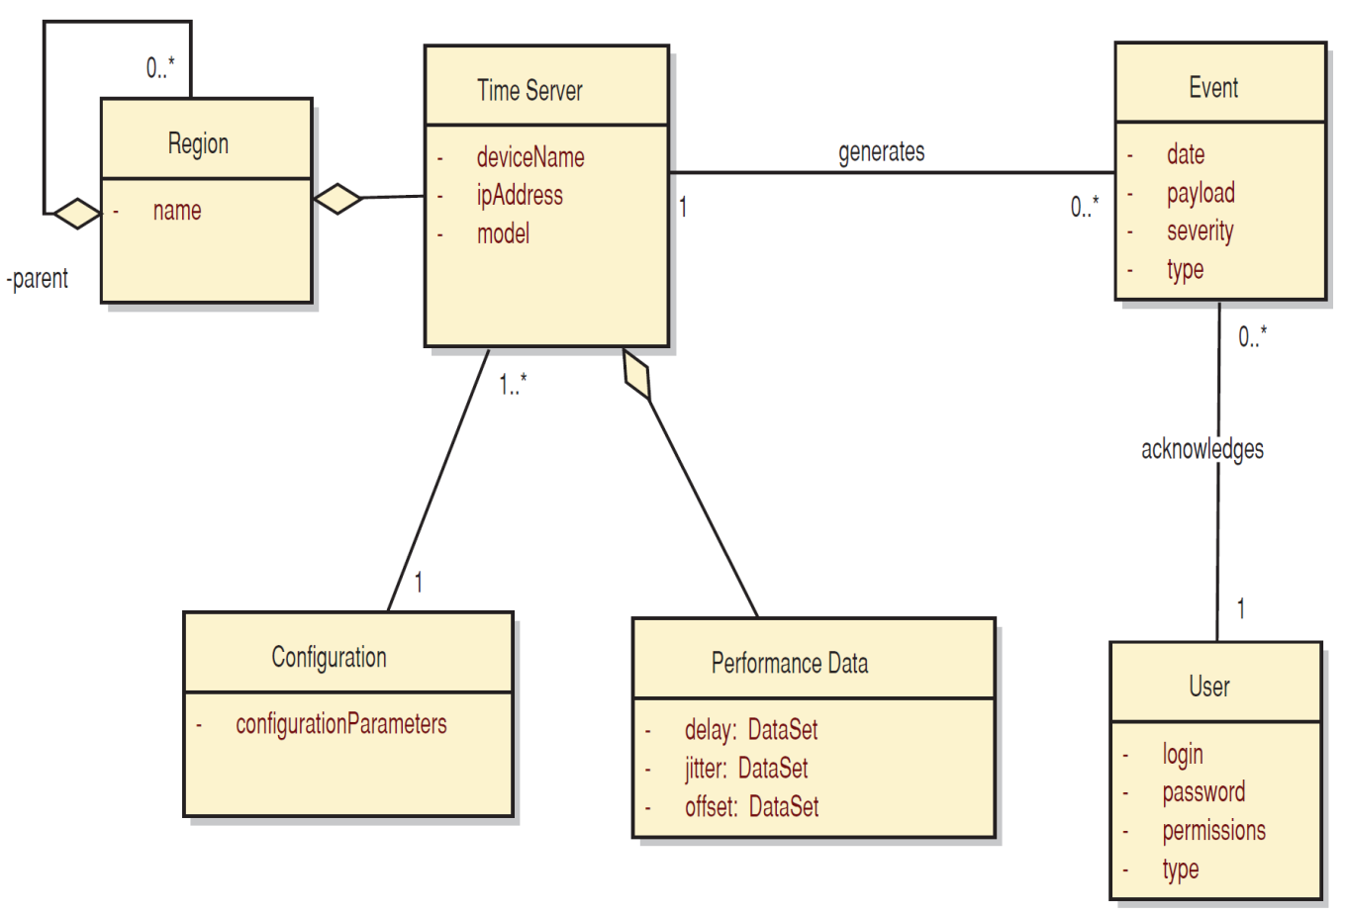
Initial Domain Model

Slide 18
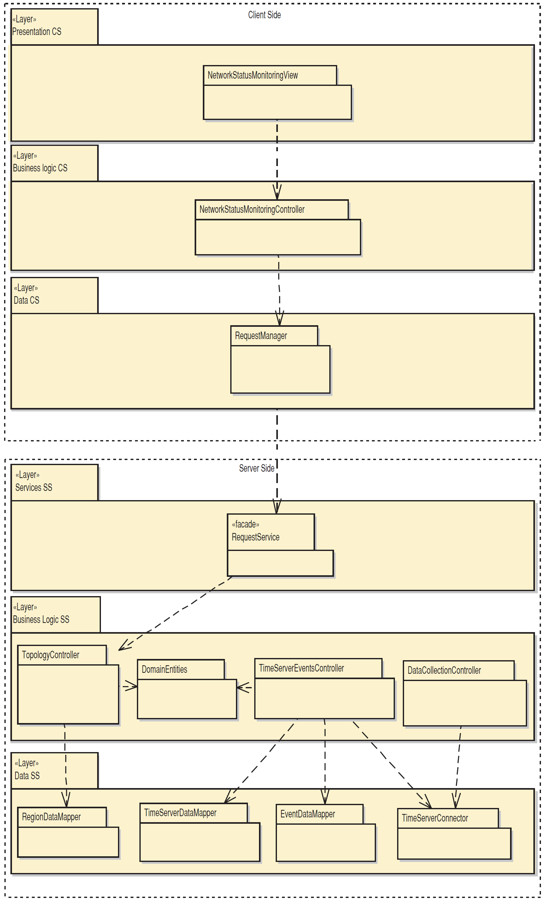
Package Diagram for the Primary Workflow
Decomposition
Reference architectures
  Clean architecture
Architectural styles
Programming languages
Technologies
Domain-driven design

Slide 19
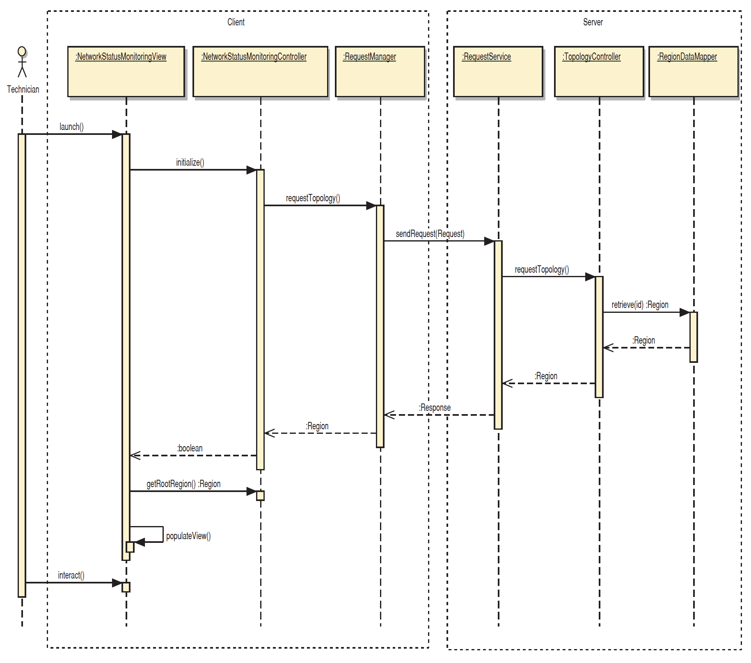
Sequence Diagram for the Primary Workflow

Slide 20
Round 3: Inputs
Overall system structure
Deployment diagram
Package diagram
Sequence diagrams
A primary workflow
A quality attribute scenarios associated with the primary workflow

Slide 21
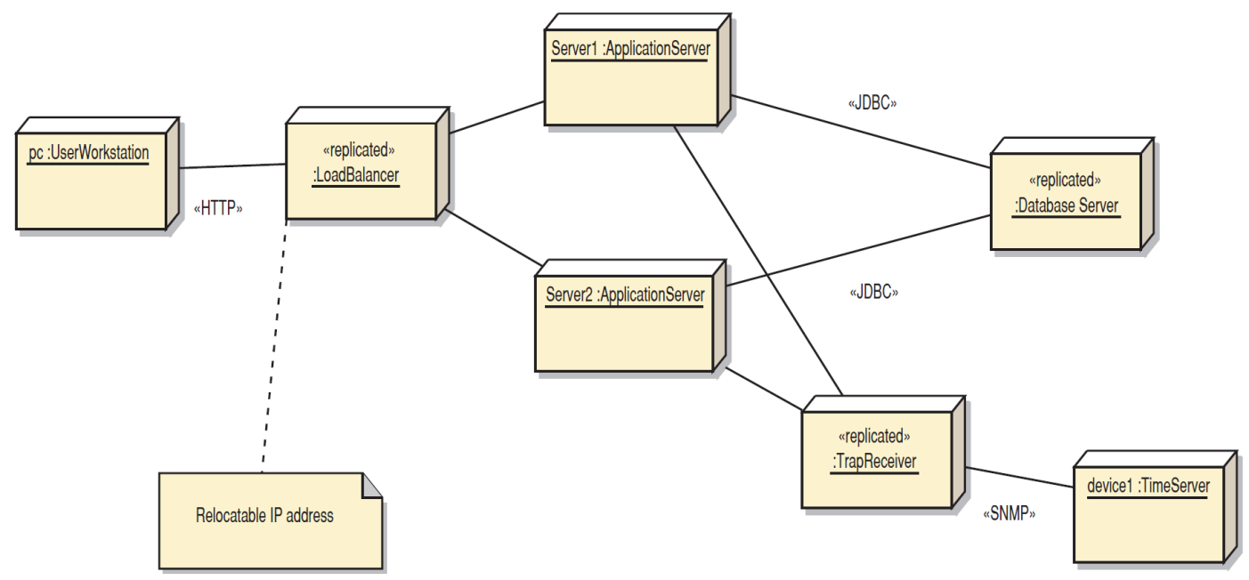
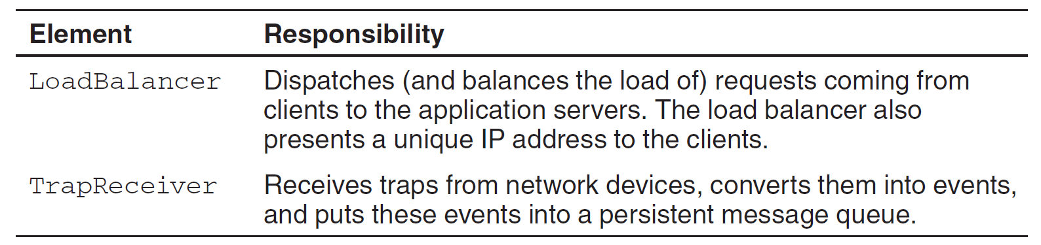
Refined Deployment Diagram
Reference architectures
Architectural styles
Programming languages
Technologies

Slide 22
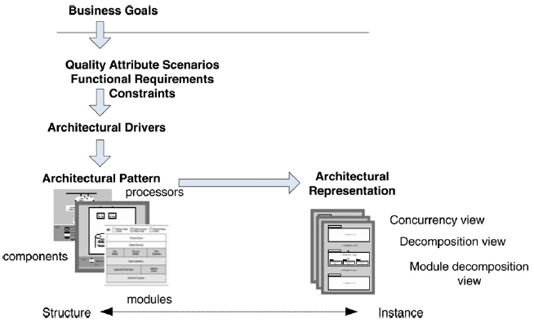
The Attribute-Driven Design
(ADD) Method Steps (I) [3]
1. Choose the module to decompose.
The module to start with is usually the whole system.
All required inputs for this module should be available (constraints, functional requirements, quality requirements)

Slide 23
The Attribute-Driven Design
(ADD) Method Steps (II)
2. Choose the architectural drivers from the set of concrete quality scenarios and functional requirements. This step determines what is important for this decomposition.
3. Choose an architectural pattern that satisfies the drivers.
Create (or select) the pattern based on the tactics that can be used to achieve the drivers.

Slide 24
The Attribute-Driven Design
(ADD) Method Steps (III)
4. Instantiate modules and allocate functionality from use cases, and represent the results using multiple views.
5. Define interfaces of the child modules.
6. Verify and refine the use cases and quality scenarios and make them constraints for the child modules.
Repeat the steps above for every module that needs further decomposition.

Slide 26
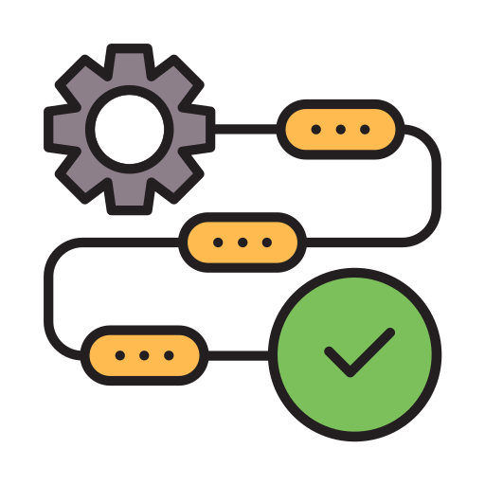
Viewpoints and Perspectives Method: Activities [4]
Agreeing on scope and context, constraints, and baseline architectural principles
Identifying and engaging stakeholders
Identifying and using architectural scenarios
Using architectural styles and patterns
Producing architectural models
Documenting the architecture
Validating the architecture

Slide 27
The Context Viewpoint
The Context view of a system defines the relationships, dependencies, and interactions between the system and its environment—the people, systems, and external entities with which it interacts.
Concerns: System scope and responsibilities.
Model: Context diagram.

Slide 28
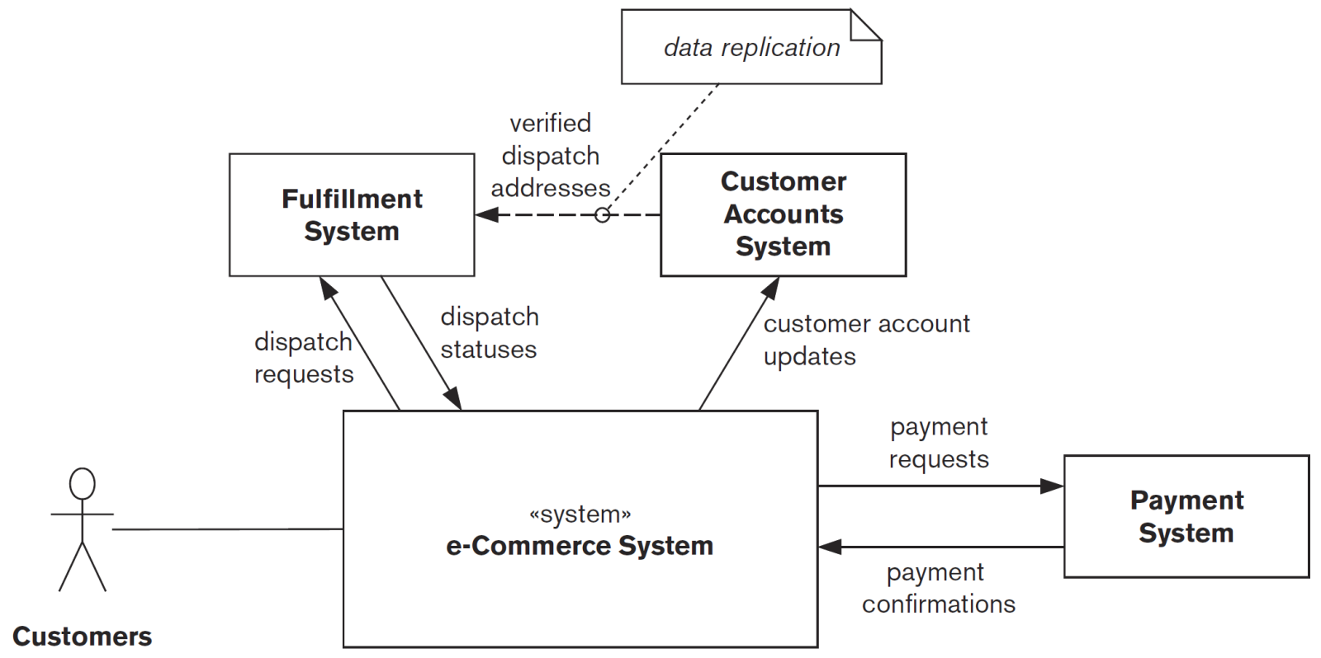
Context View Example
ONLINE RETAIL SYSTEM DEPENDENCIES

Slide 29
The Functional Viewpoint
This view documents the system’s functional structure—including the key functional elements, their responsibilities, the interfaces they expose, and the interactions between them.
Concerns: Functional capabilities, External Interfaces, Internal Structure, Functional Design Philosophy.
Model: Functional structure model (UML component diagrams, Boxes-and-lines diagrams).

Slide 30
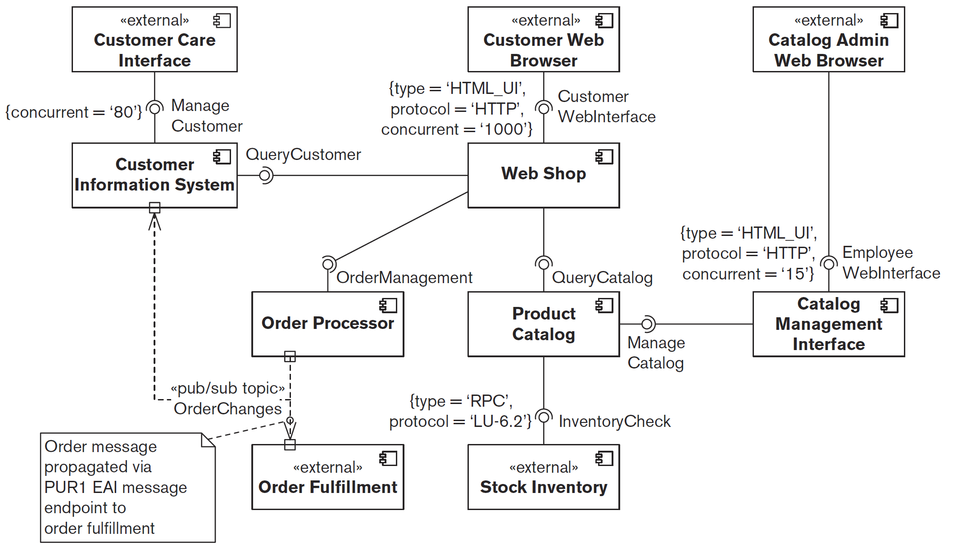
Functional View Example
Web Shop

Slide 31
The Information Viewpoint
You use the Information view to answer, at an architectural level, questions about how your system will store, manipulate, manage, and distribute information.
Concerns: Information Structure and Content, Information Purpose and Usage, Information Ownership, Enterprise-Owned Information, Identifiers and Mappings, Volatility of Information Semantics, Information Storage Models, Information Flow, Information Consistency, Information Quality, Timeliness, Latency, and Age, Archiving and Information Retention.
Model: Static information structure models (entity-relationship diagrams, UML class diagrams, data flow diagrams, UML state diagrams).

Slide 32
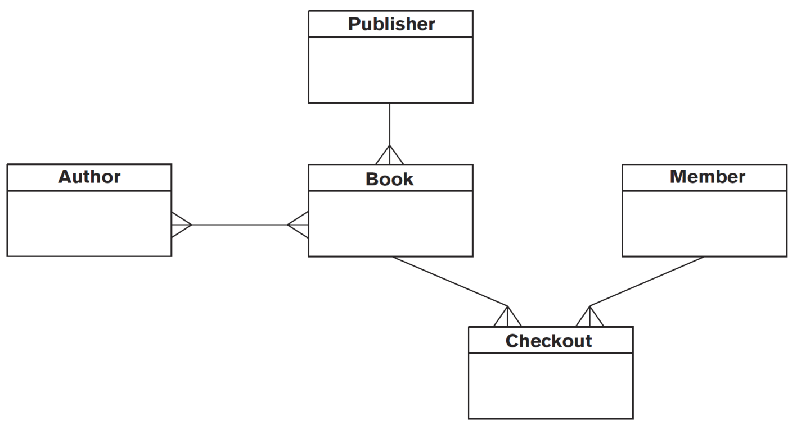
Information View Example
ENTITY-RELATIONSHIP DIAGRAM FOR LIBRARY

Slide 33
The Concurrency Viewpoint
The Concurrency view is used to describe the system’s concurrency and state-related structure and constraints. This involves defining the parts of the system that execute at the same time and how this is controlled.
To do this, you need to create a process model and a state model: The process model shows the planned process, thread, and inter-process communication structure; the state model describes the set of states that runtime elements can be in and the valid transitions between those states.
Some information systems have little concurrency. Others, while exhibiting concurrent behavior, use the facilities of underlying frameworks and containers (e.g., application servers and databases) to hide the concurrency model in use.
Many of today’s information systems are inherently event-driven, reactive, concurrent systems.
Concerns: Task (Process or Thread) Structure, Inter-process Communication, State Management, Synchronization and Integrity, Supporting Scalability, Task Failure,
Model: System-Level Concurrency Models, State Models.

Slide 34
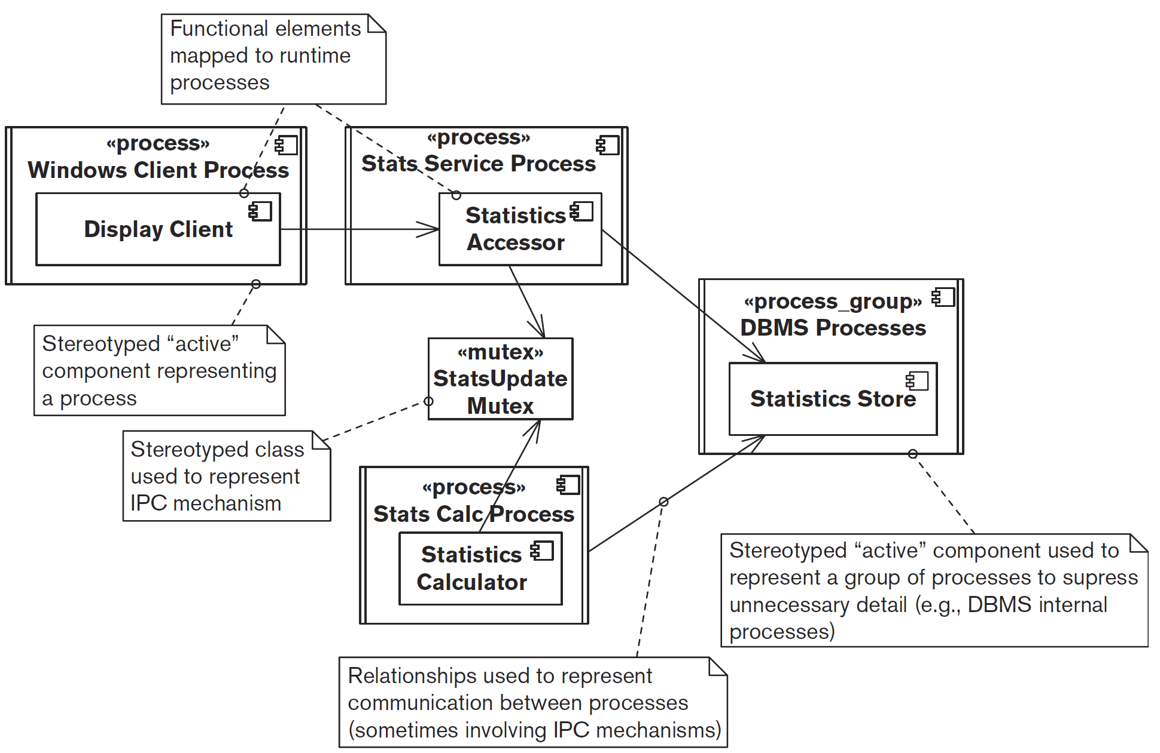
Concurrency View Example 1
The concurrent activity between the Statistics Accessor and Statistics Calculator components needs to be coordinated.

Slide 35
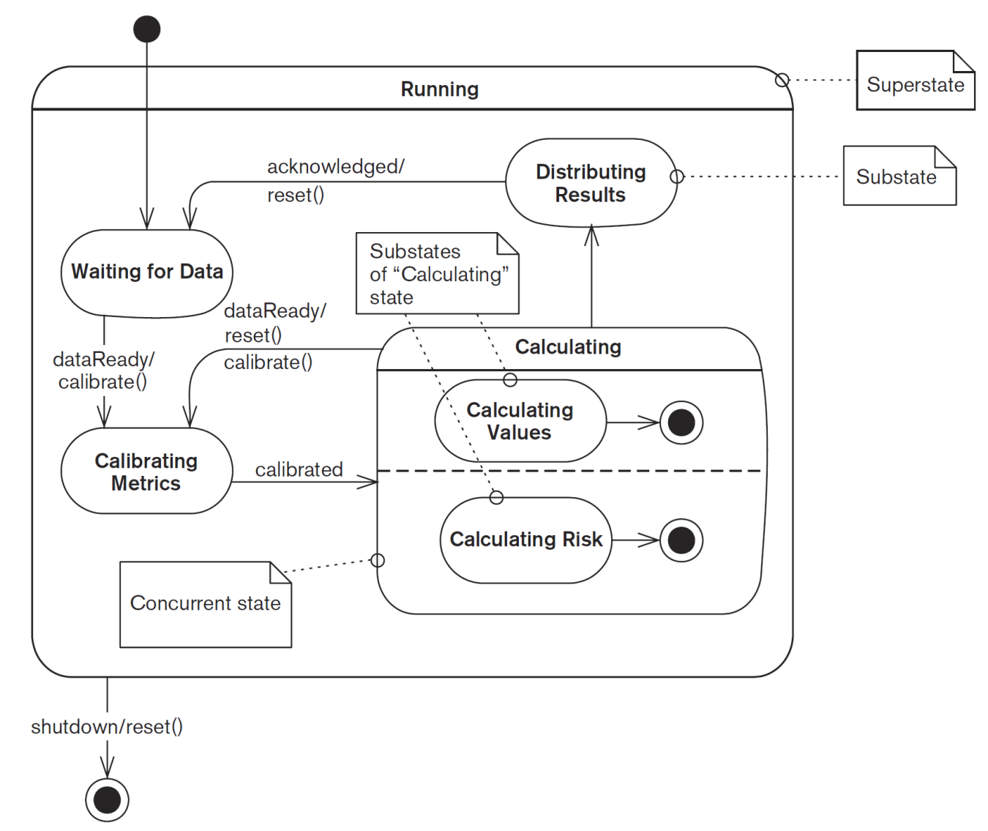
Concurrency View Example 2
The Calculating state is interesting because it is a concurrent state, as you can see from the dashed line that bisects it.
This means that while in the Calculating state, the element is actually in two concurrent substates (Calculating Values and Calculating Risk).

Slide 36
The Development Viewpoint
It is this view that addresses the specific concerns of the software developers and testers.
The importance of this view depends on the complexity of the system being built, the expertise of the software developers, the maturity of the technologies used, and the familiarity that the whole team has with these technologies.
Concerns: Module Organization, Common Processing, Standardization of Design, Standardization of Testing, Instrumentation, Codeline Organization.
Model: Module Structure Models (UML package diagrams).

Slide 37
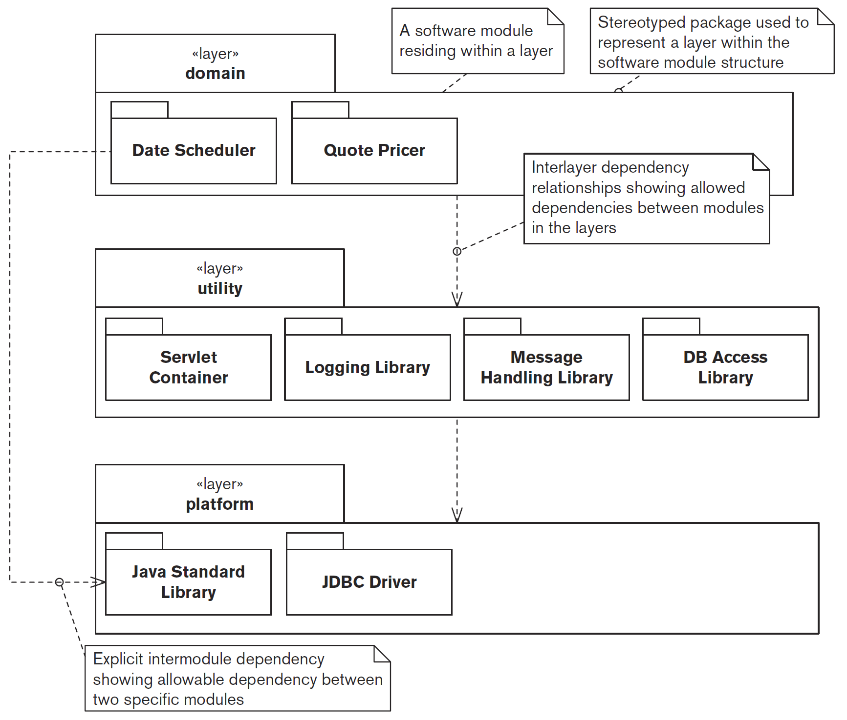
Development View Example

Slide 38
The Deployment Viewpoint
This view defines the physical environment in which the system is intended to run, including the hardware or hosting environment (e.g., processing nodes, network interconnections, and disk storage facilities), the technical environment requirements for each type of processing node in the system, and the mapping of your software elements to the runtime environment that will execute them.
Concerns: Runtime Platform Required, Specification and Quantity of Hardware or Hosting Required, Third-Party Software Requirements, Technology Compatibility, Network Requirements, Network Capacity Required, Physical Constraints.
Model: Runtime Platform Models, Network Models.

Slide 39
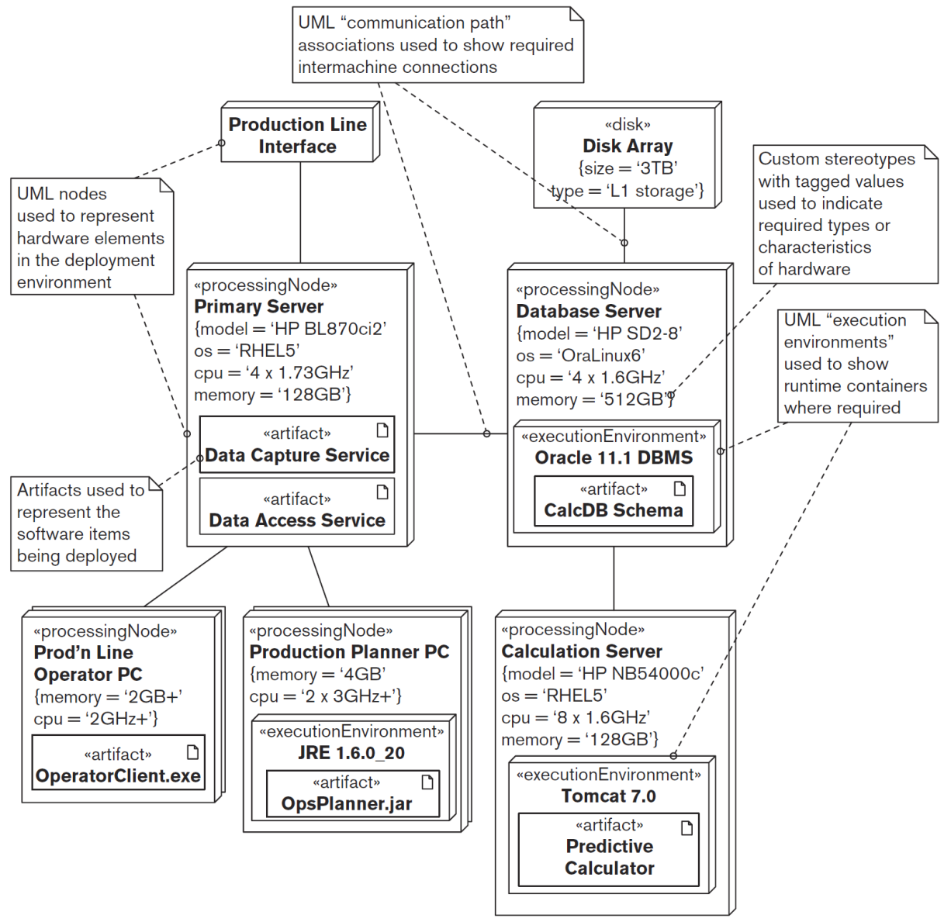
Deployment View Example 1
Runtime Platform Model

Slide 40
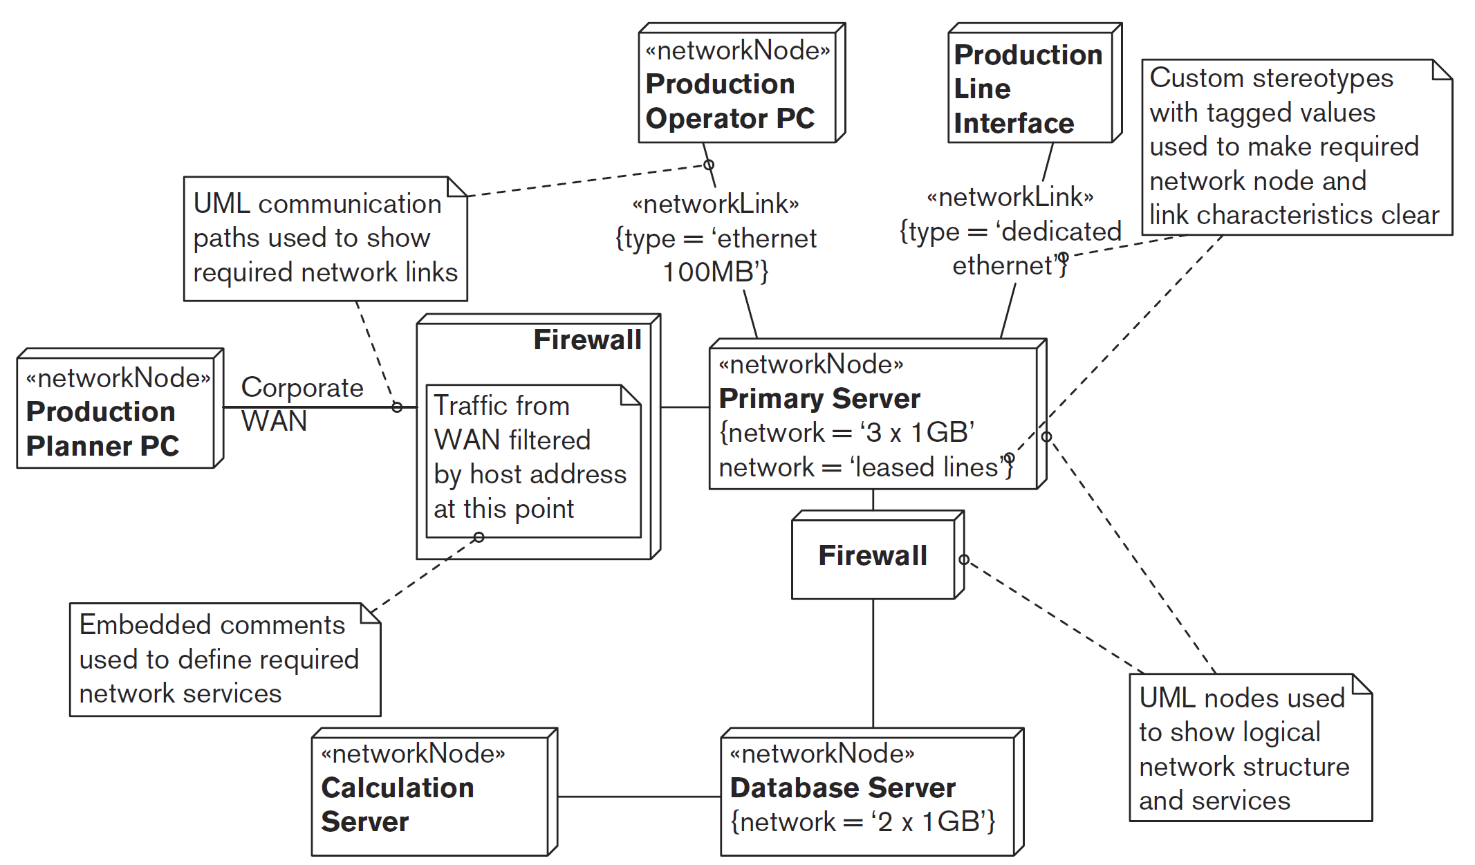
Deployment View Example 2
Network Model

Slide 41
The Operational Viewpoint
The aim of the Operational viewpoint is to identify a system-wide strategy for addressing the operational concerns of the system’s stakeholders and to identify solutions that address these.
Concerns: Installation and Upgrade, Functional Migration, Data Migration, Operational Monitoring and Control, Alerting, Configuration Management, Performance Monitoring, Support, Backup and Restore, Operation in Third-Party Environments.
Model: Boxes-and-lines diagrams.

Slide 42
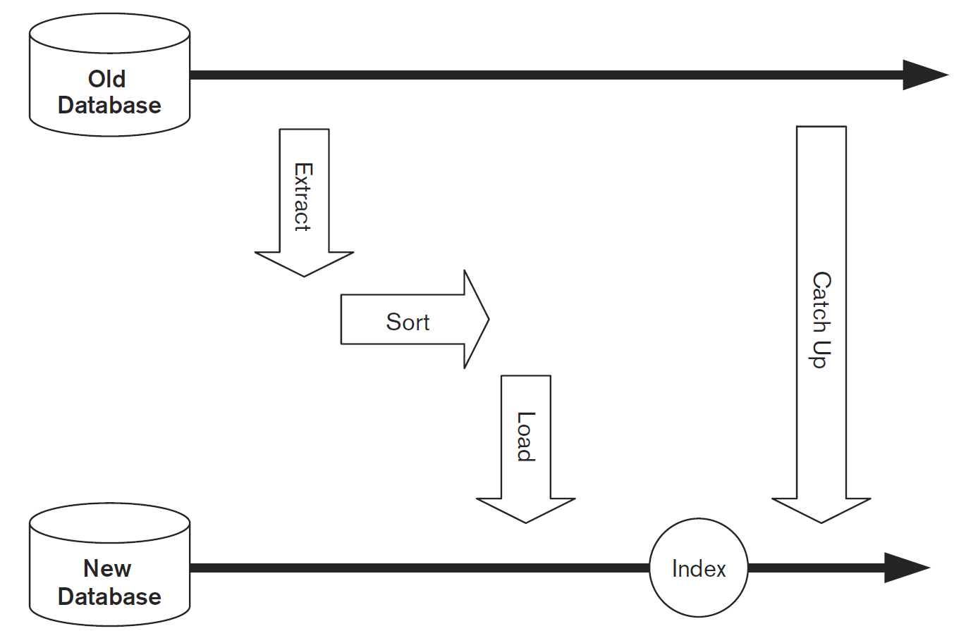
Operational View Example
Data Migration Example.
It will not be possible to halt the country’s tax-collection activities for two weeks while the data is migrated.
Special code therefore has to be written to capture these updates as they occur and to apply them to the new system once the bulk of the data has been migrated into it, so that the extract is complete.

Slide 43
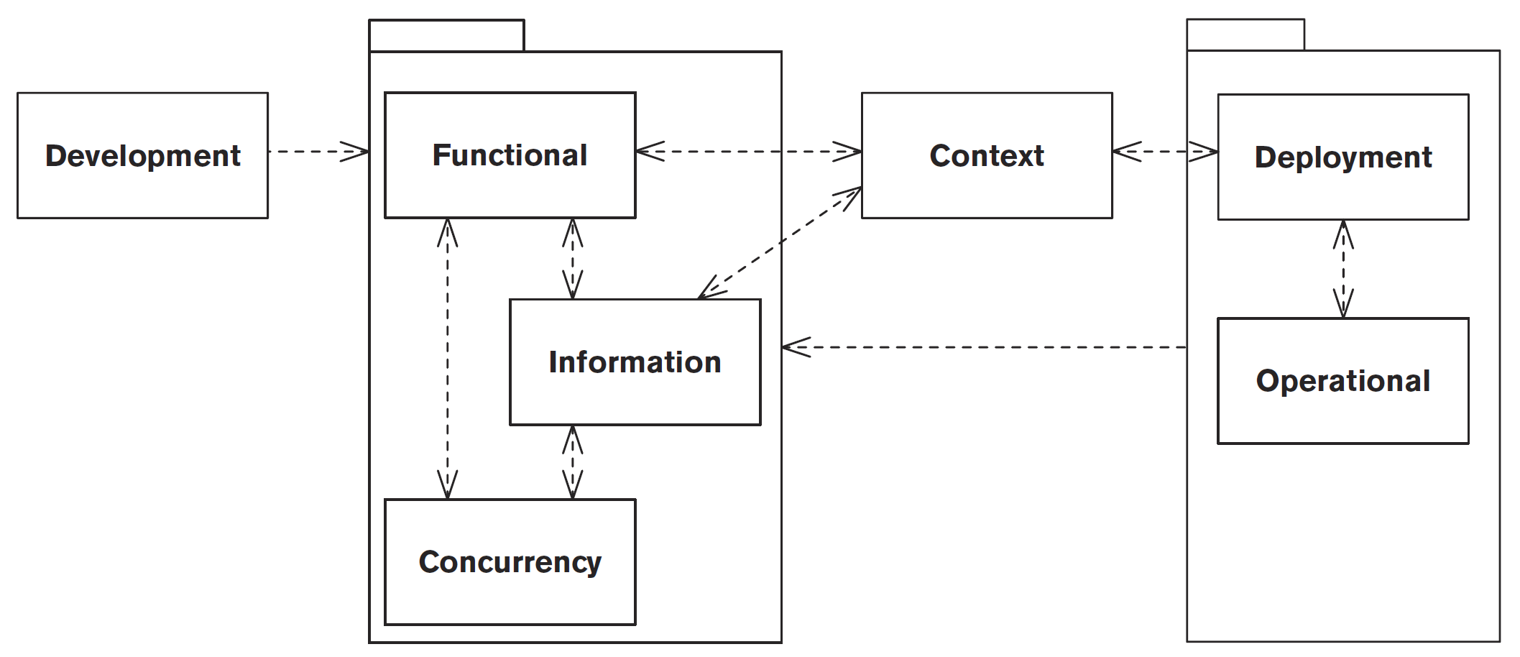
Dependencies Between Views

Slide 44

Core Perspectives
Security.
Performance and Scalability.
Availability and Resilience.
Evolution.

Slide 45
Perspective Details
The perspective’s applicability to views—that is, which of your views are most likely to be impacted by applying the perspective.
The most important concerns the perspective addresses.
A description of activities for applying the perspective to your architecture.
The key architectural tactics to be considered as possible solutions when your architecture does not exhibit the required quality properties the perspective addresses.
Some problems and pitfalls to be aware of and risk-reduction techniques for mitigating these.
Checklists of things to consider when applying the perspective and when reviewing it, to help ensure correctness, completeness, and accuracy.

Slide 47
RUP’s Architectural Design Activities [3]
Architectural design activities in RUP start with the following artifacts, which may not be finalized and still evolve during the architectural design:
  a vision document,
  a use case model (functional requirements) and
  supplementary specification (non-functional requirements, quality attributes).
The three main groups of activities are:
  Define a candidate architecture. This usually starts with a use-case analysis, focusing on the use cases that are deemed architecturally significant, and with any reference architecture the organization may reuse.
  Perform Architectural Synthesis. Build an architectural proof-of-concept, and assess its viability, relative to functionality and to non-functional requirements.
  Refine the Architecture. Identify design elements (classes, processes, etc.)

Slide 48
Application-Generic Knowledge: Patterns, Standards, Frameworks
Patterns
  Gang of Four
  Buschmann and his Gang of Five.
Standards
  TOGAF (The Open Group Architectural Framework)
  Zachman Framework
  ISO 19439 (FDIS), etc.
Frameworks
  IEEE Std 1471
  ISO/IEC 42010, etc.

Slide 50
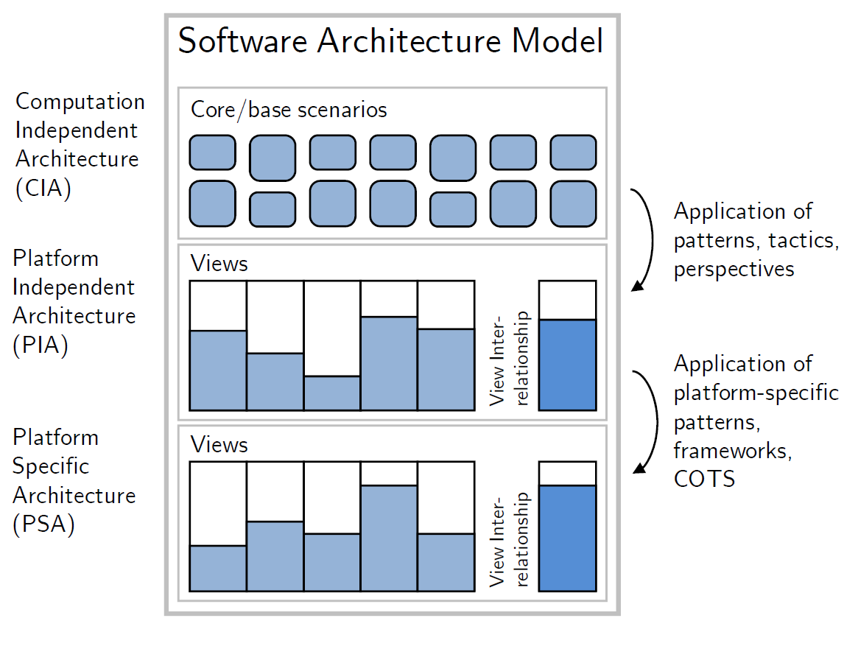
Model-Driven Approach [5]
A specialization of the ADD method, using Model-Driven Engineering techniques, that systematizes and assists the Decision Making activity.
The architecture representation is precisely stated.
  six architectural viewpoints, each addressing a cohesive set of architectural concerns: Functional, Information, Concurrency, Development, Deployment, and Operational.
  use UML notation for depicting models, and somehow complement the language definitions provided by the view type approach.
  structure architectural views in three levels of abstraction.

Slide 51
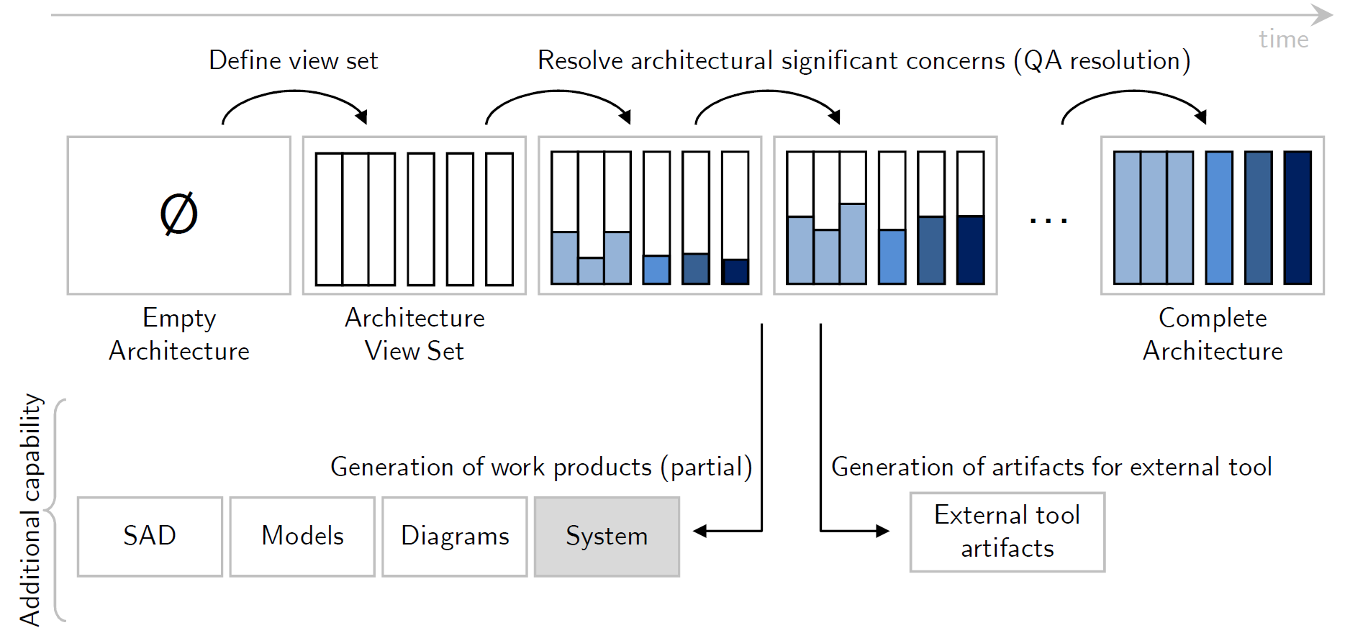
Model Transformations
The method is understood as the successive application of model transformations, starting from an empty representation and ending with the complete architecture representation.

Slide 53
How to Create an Architecture? [6]
Impose architectural style
Impose architectural pattern
Apply design pattern
Convert NFRs to functionality
  Exception handling is a well-known example that adds functionality to a component to increase the fault-tolerance of the component.
Distribute requirements
  The divide-and-conquer principle: a NFR at the system level is distributed to the subsystems or components that make up the system.

Slide 54

Thank You & See You Again

